Slide 1

San Diego Sports
Prepared by
Dominic Leggio
Mohammed Ali Khan
Tian Gao
Manish Chandra Reddy Kadira

Slide 2
Inspiration
Sandiegobasketball.com
Wanted to improve the existing website and provide an opportunity for the league to scale into other sports
Goal

Slide 3

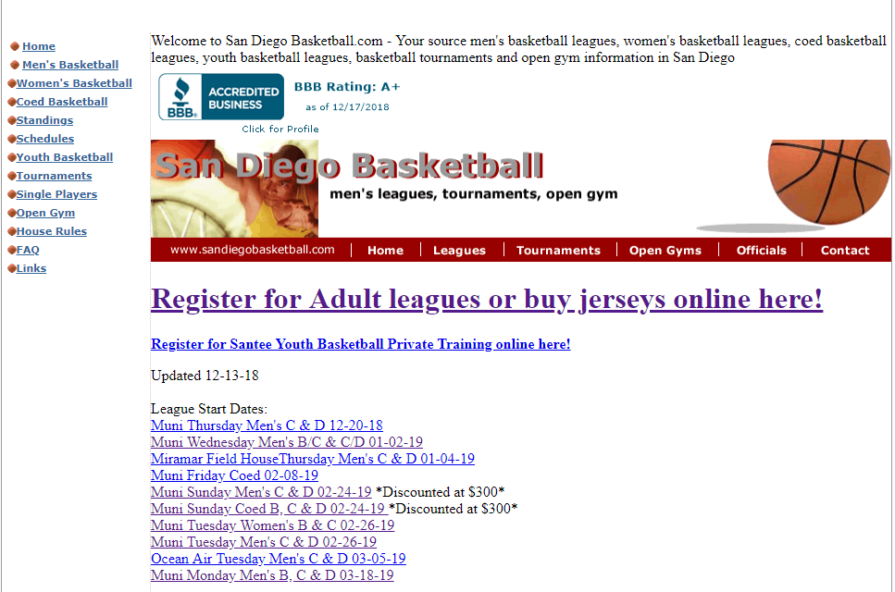



Current site

Slide 4
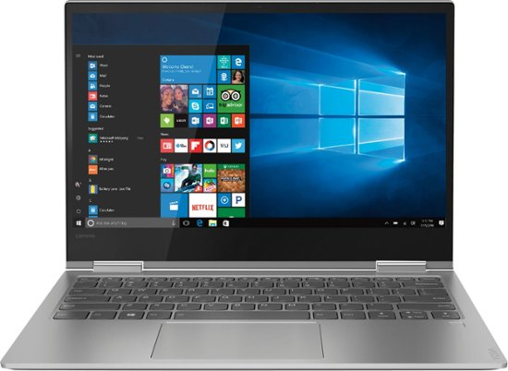




High Level Design
Web Browser
Web Browser

Slide 5

Hardware & infra-structure
Database Server
MongoDB
24/7 & 99% uptime cloud server
Web Server
Coding by Node.js
JavaScript with ultrafast V8 engine
Minimum System Requirements
For website user: Pentium 1.8GHz CPU, 2GB RAM, with Chrome, IE, or Firefox browser
For smartphone user: Android 6 or above, 1GB RAM, 8GB ROM

Slide 6



Technology stack
Angular framework
Node.js backend
Express routing
MongoDB

Slide 7
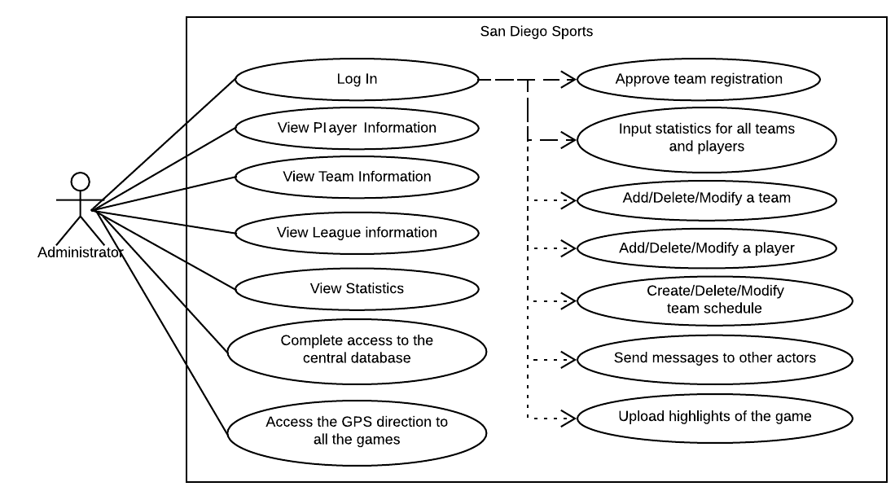
Use Case - Admin

Slide 8
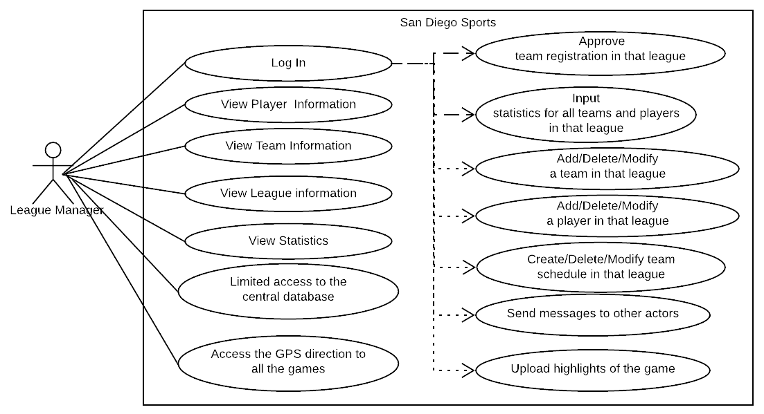
Use Case – League Manager

Slide 9
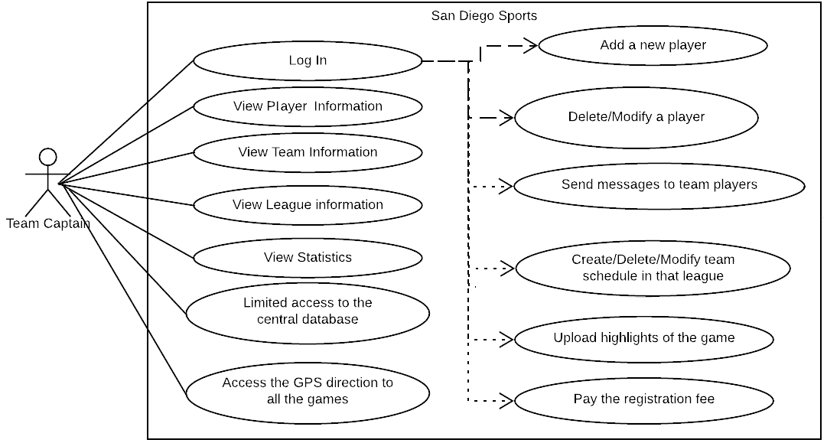
Use Case – Team Captain

Slide 10
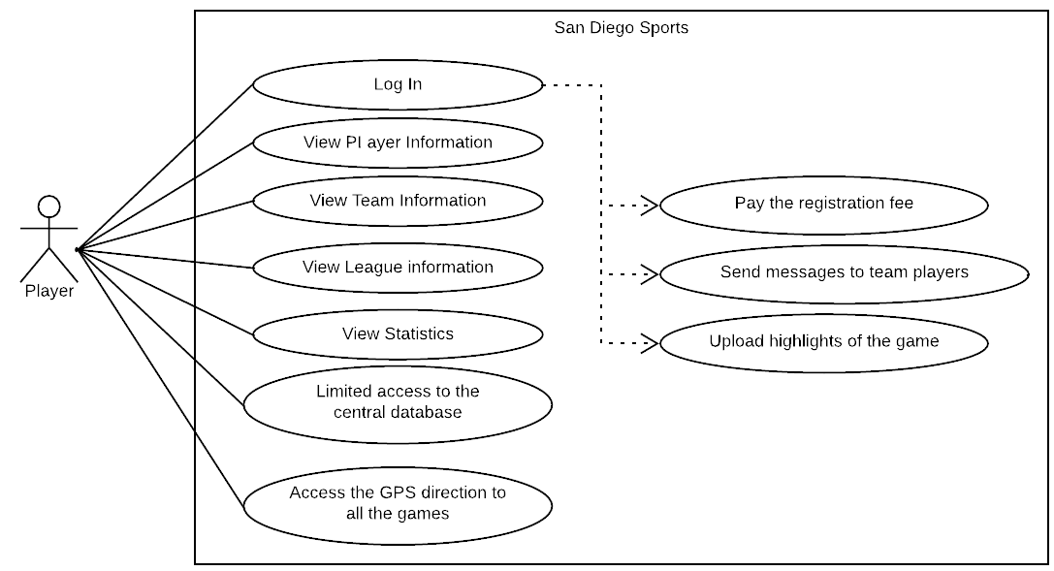
Use Case – Player

Slide 11
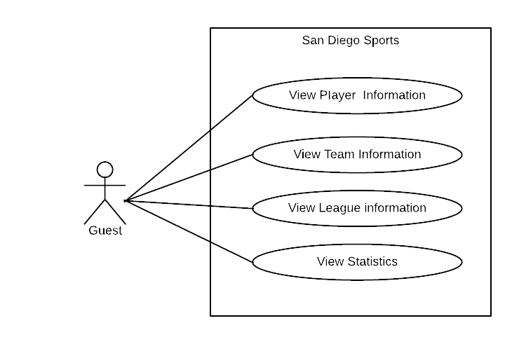
Use Case – Guest

Slide 12
Database - Schema

Slide 13
Features
Create user ID/password
Create team
Add players
GPS
Statistics
Create a schedule
Pay registration fee

Slide 14
Create User ID/Password
Let’s you create an account.
Let’s you set a password for the account you created.
Gives you access to a few more features than the guest account.
Enables a whole new experience.

Slide 15
Create a Team and add Players
Let’s you create a team.
Let’s you give a name to your team.
Let’s you add players to your team.
Helps you maintain a competitive squad.

Slide 16
GPS
Helps you locate the venue.
Is connected to google maps.
Can never go wrong with google maps accuracy.

Slide 17
Statistics
Gives you a complete list of the overall standings.
Gives you a complete list of individual as well as team statistics.
Helps you view top teams and team performers in one click.
Keeps the weekly stats ticking.
Leaderboards, Spotlights, Top performers and what not!

Slide 18
Create a schedule
Helps you schedule games.
Gives the teams and fans a clearer picture of when and where the games will be.
Puts up a readily available schedule for teams to look at without confusion.

Slide 19
Pay registration
Allows you to pay the registration with ease.
Eliminates the hustle bustle of collecting registration from each and every team player.
Provides an efficient platform for players to pay upfront.

Slide 20
Website User Experience

Slide 21
Access the link for the Prototyes https://xd.adobe.com/view/060b58a2-2a31-4859-7c72-9249ae791baa-703a/?fullscreen

Slide 22
Mobile App development
We are developing a mobile app for these actors
Guests / Fan
Team members / player
Team captain
League manager
System administrator
The app is being developed with Java, SQL, and Rapid Development technology.
The app is will be available on Android 6.0 or above.

Slide 23
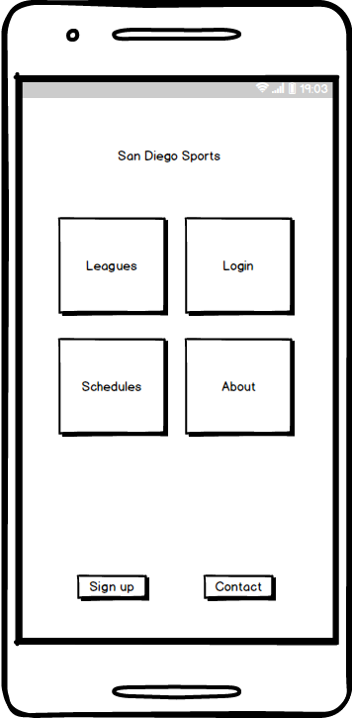
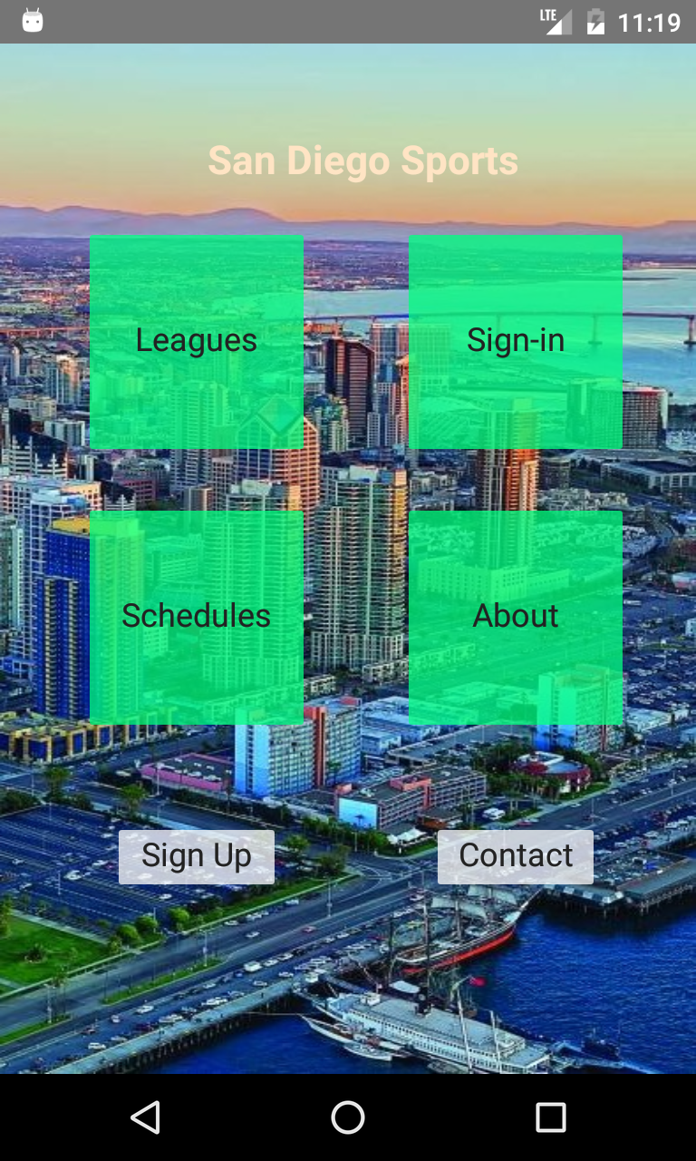
Mobile UI - Home Page
Home page design
Home page on Android

Slide 24
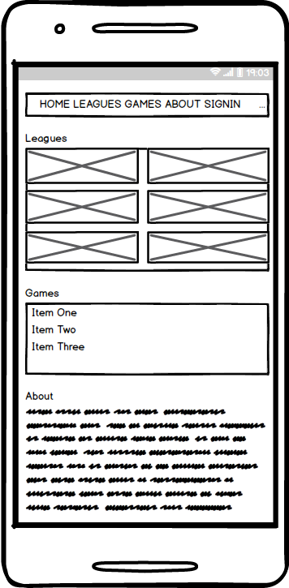
Mobile UI - List all leagues
The page list all leagues information and all games

Slide 25
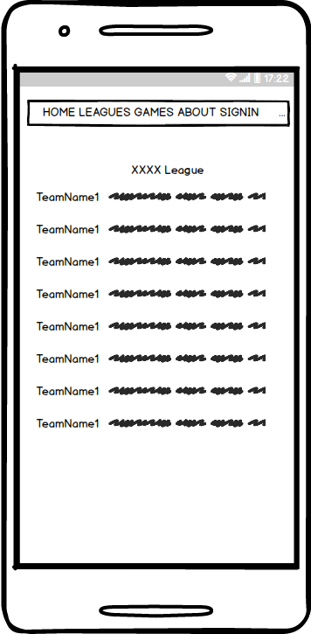
Mobile UI - List all teams in a league
The page list all teams’ information in a league

Slide 26
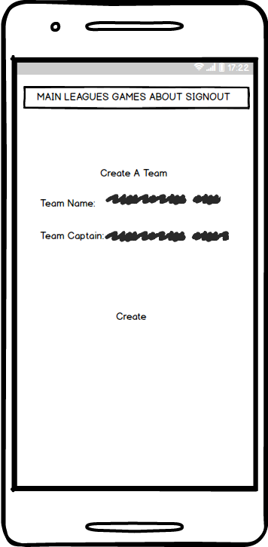
Mobile UI - Create team / league
UI for creating a team or league

Slide 27
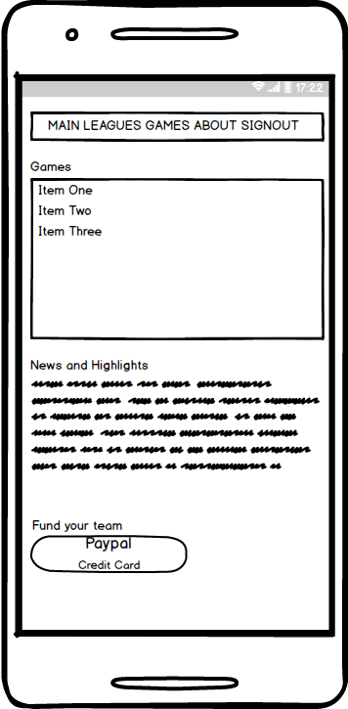
Mobile UI - Team player’s page
UI for team player’s main page
Team captain and league manager’s main page designs are similar

Slide 28
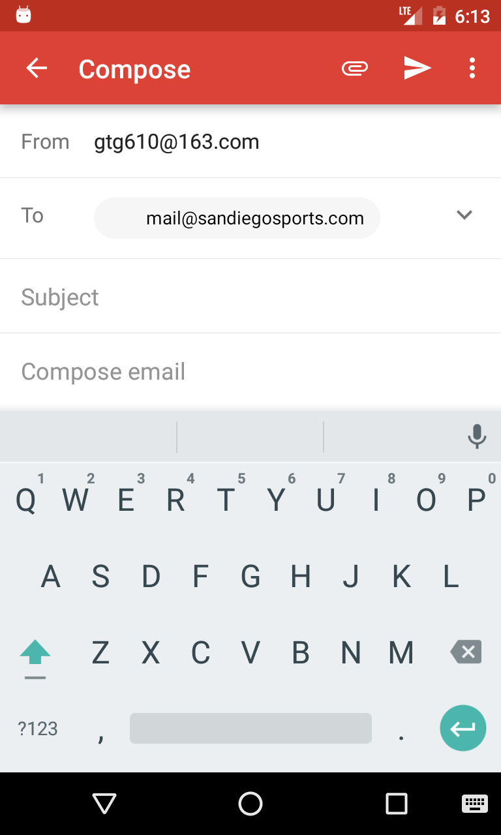
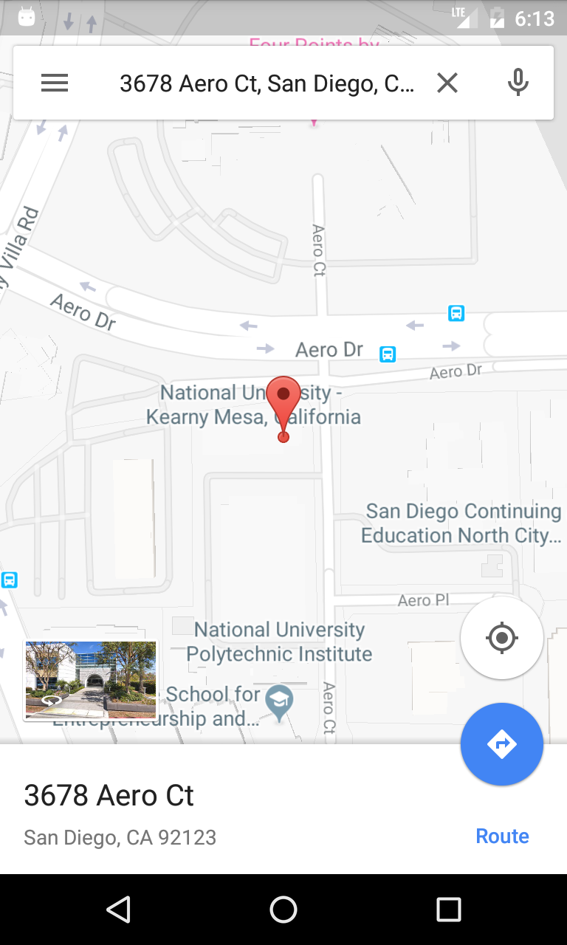
Mobile UI - Other design
Send a email in app
Map on Android

Slide 29
Testing
Testing and QA are very important parts of our project.
We have a complete plan of testing including the following test case.
Login testing case
Viewing team schedules testing case
Sign-up testing case
Recruiting testing case
Password reset testing case

Slide 30
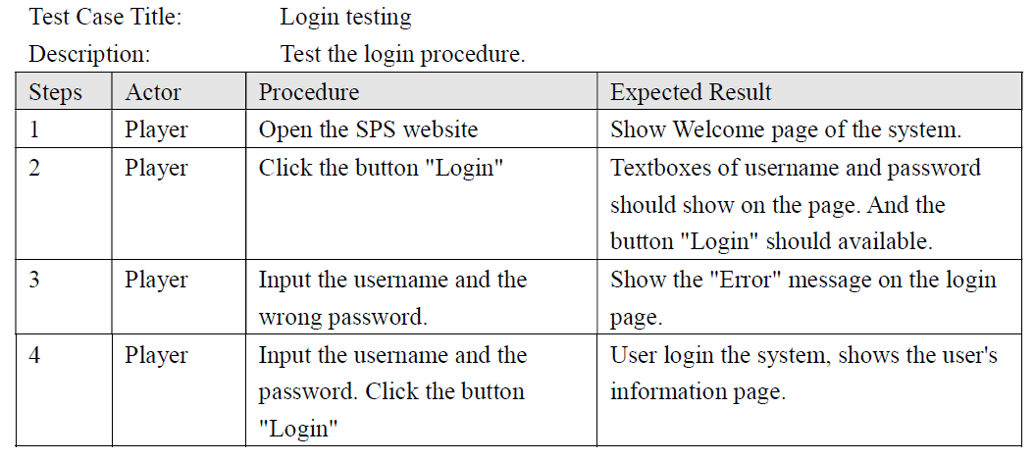
Testing Case - Login

Slide 31
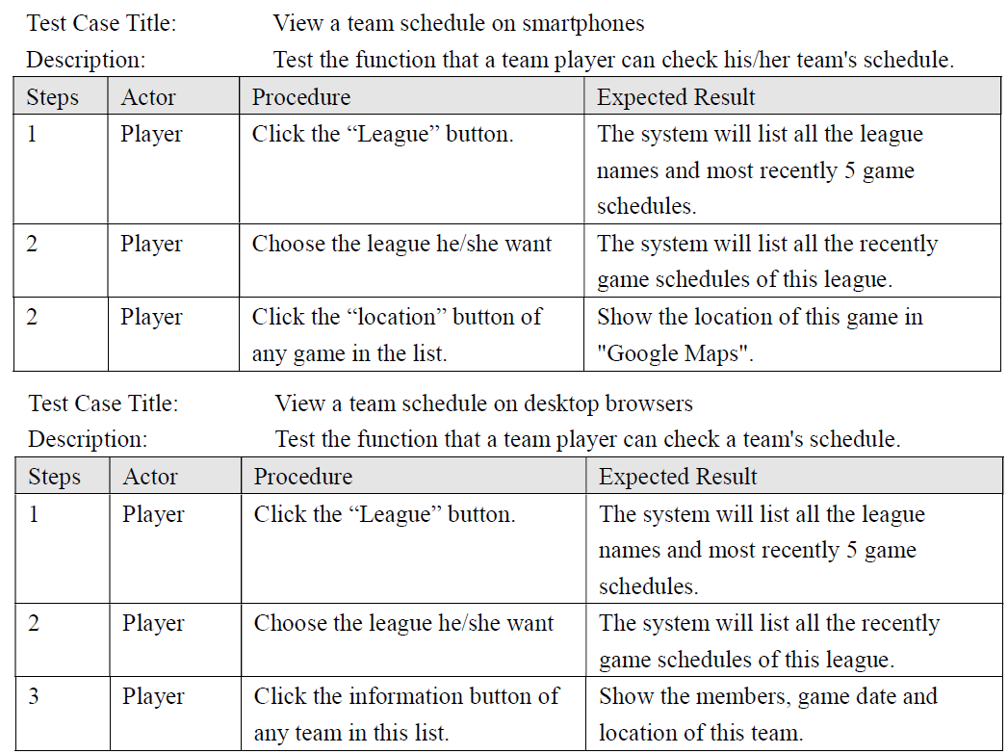
Testing Case - Check Schedule

Slide 32
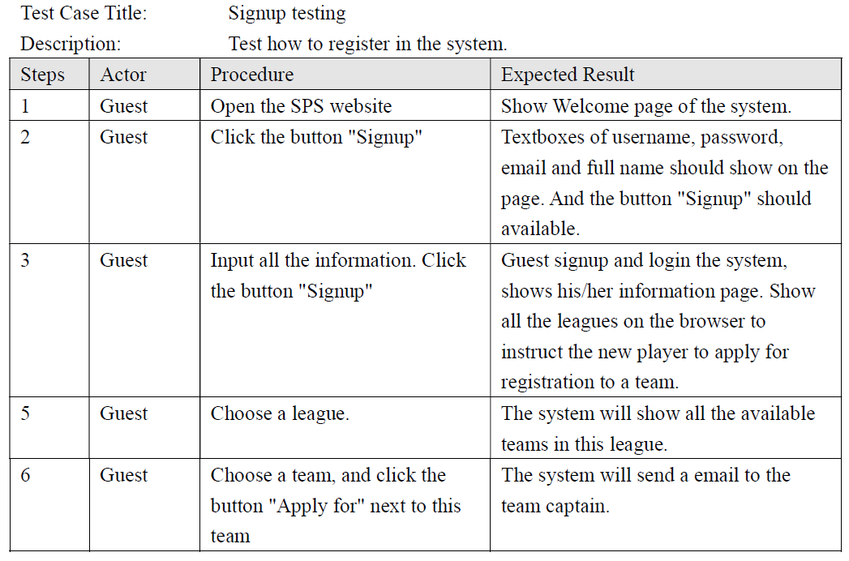
Testing Case - Signup

Slide 33
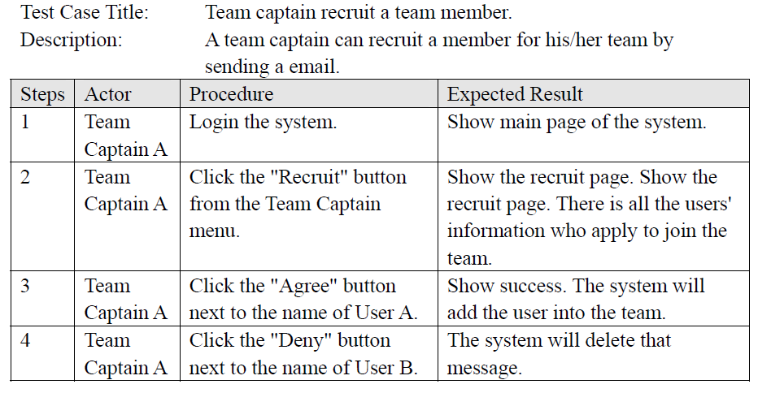
Testing Case - Recruiting

Slide 34
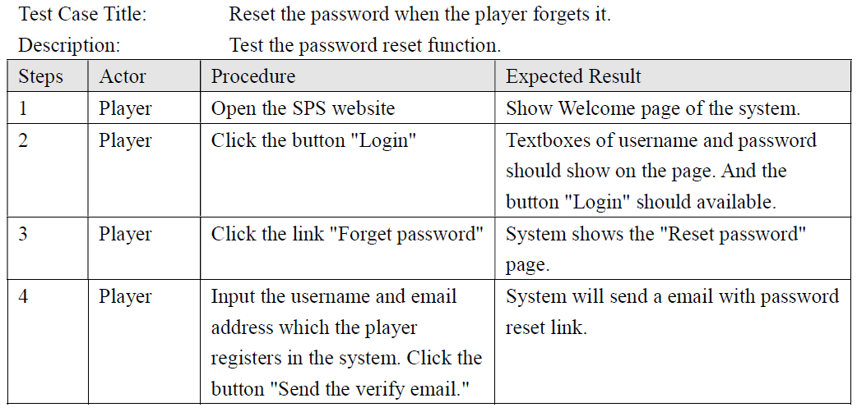
Testing Case - Reset password

Slide 35
Conclusion
We are looking to replace sandiegobasketball.com with an updated UI and additional features to enhance the user experience.
We are developing an Android app to go alongside.

